Slide 1
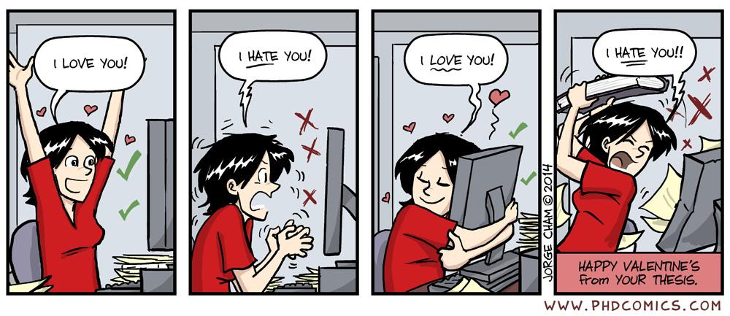
User interface design

Slide 2
UI Design: Week 7, Monday
Dr. Jillian Aurisano
Plan for today:
Announcements/Course logistics
People- part 1
Activity- project activity
Notes:
So welcome to engineering visual interfaces for data science. I'm Dr Aurisano.
Thanks for finding the class on Zoom. Hopefully we will be in person again soon.
If anyone out there is comfortable turning on their cameras, that is lovely- then I feel like I am talking to students, rather than to myself.
Here’s our plan for today:
First I’m going to introduce myself, so you know a bit about me
Then we are going to get to know each other, in Zoom breakout rooms. This will give us a chance to make sure that Zoom breakout rooms work, and we all know how to access them.
Then, I am going to walk through the structure, and plan for the course. I want to make sure everyone knows how the course will work, and what to expect, and also a bit about why the course is designed this way.
Then I am going to introduce the class, and what the class is about. Since this is a new class, and one of just a few classes in human centered computing here at UC, I wanted to give an overview of the topic.
Then I have an introductory activity, which we will do in breakout rooms, and which I think will help motivate the discussion on Wednesday, and getting into the meat of the class.

Slide 3
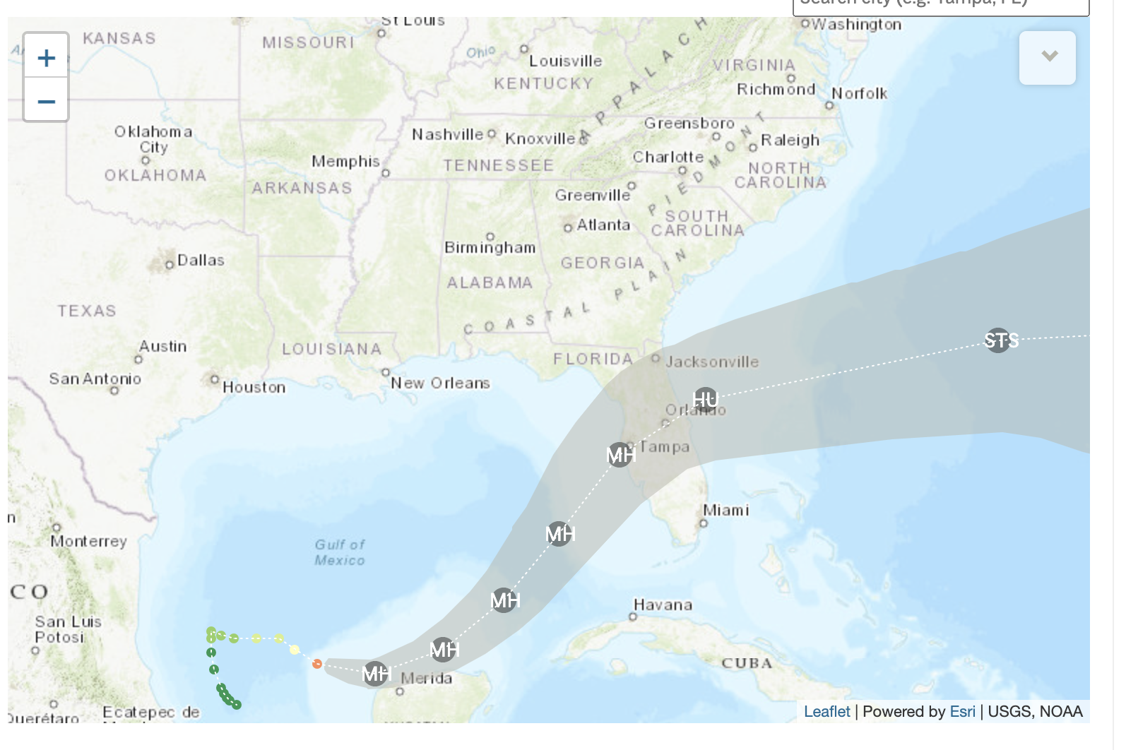
Next week
I am supposed to be in Tampa for a conference but….
Will keep you posted

Slide 4
Project 2
Questions?

Slide 5
Let’s talk about people
Let’s look a bit more closely at our human users of the interfaces we are building

Slide 6
Understanding people
How we see, think, listen, remember, decide…
This is determined by the structure and operation of our brain
Some activities we do effortlessly
Some activities we struggle with
Understanding how our brains work, will help us design better interfaces that works better with people

Slide 7
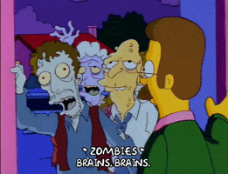
Brains!!!

Slide 8
Our brains interpret reality
We don’t just passively read in the world
Our brains interpret what the visual system brings in
Our brains impose structure, where it thinks structure is appropriate
This is influenced by ‘priors’ (our experiences)
We have a model of the world
We try to fit what we see into this model

Slide 9
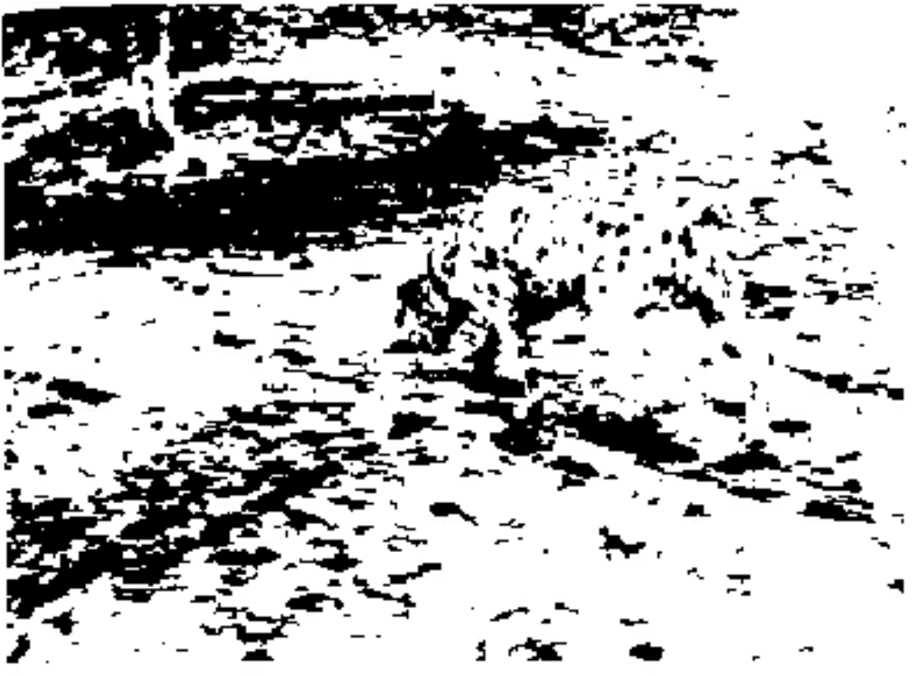
Who can see something here?
Emergence of images

Slide 10
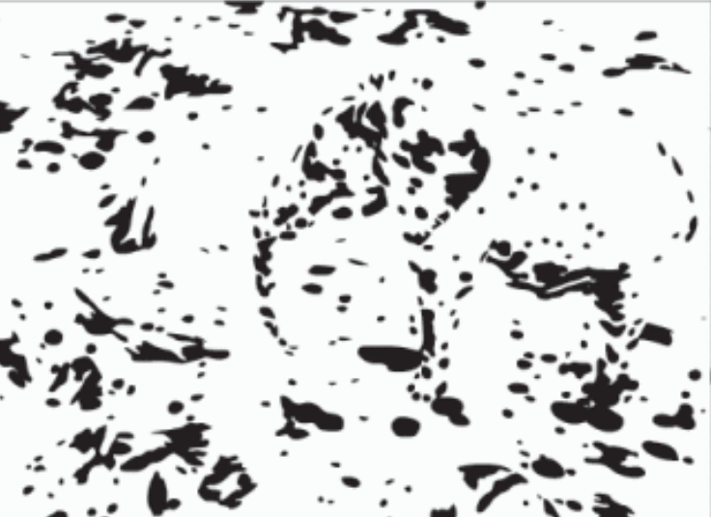
What about here?

Slide 11
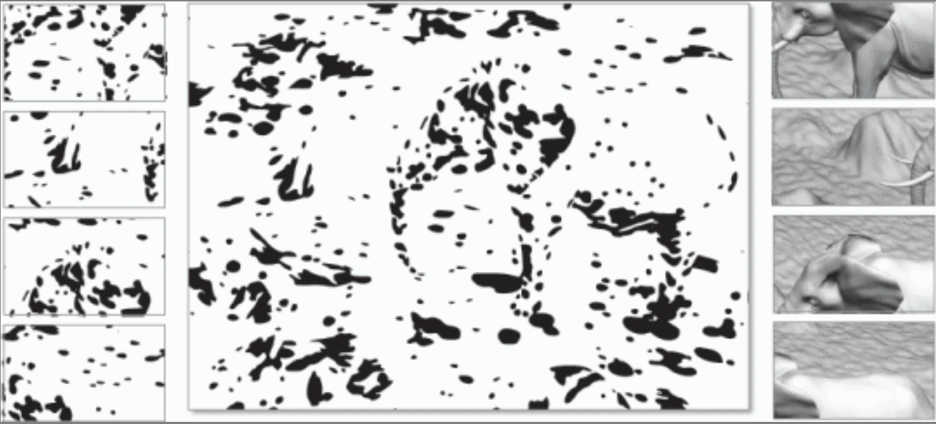
Need to see the whole- just looking at parts does not work
We need the whole picture
Our mind matches the concept with the features as a whole
http://graphics.stanford.edu/~niloy/research/emergence/emergence_image_siga_09.html

Slide 12
Perception is based on priors
We have a model of the world
Expectations
Prior experiences
Our perceptual systems take in raw information and then our brains try to fit raw information into a model

Slide 13
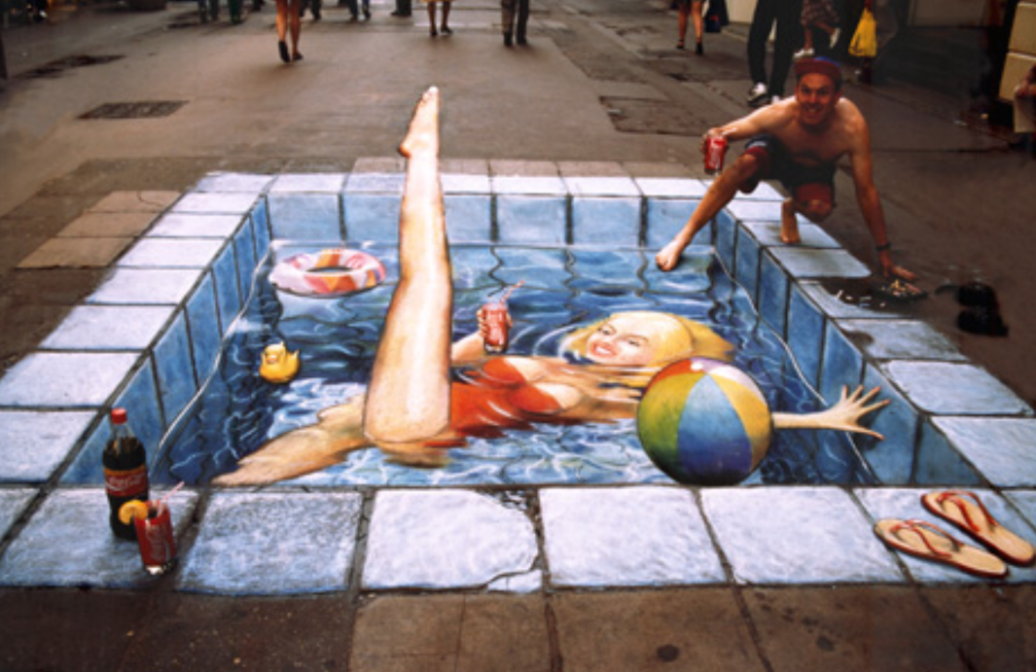
What we see

Slide 14
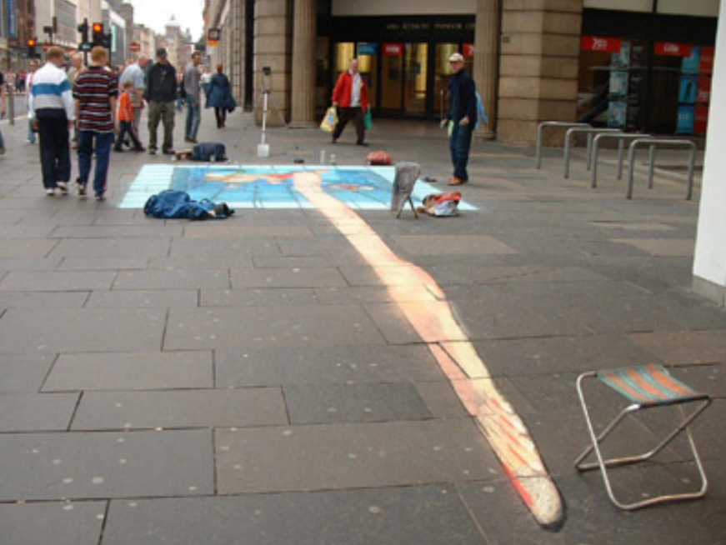
What is there

Slide 15
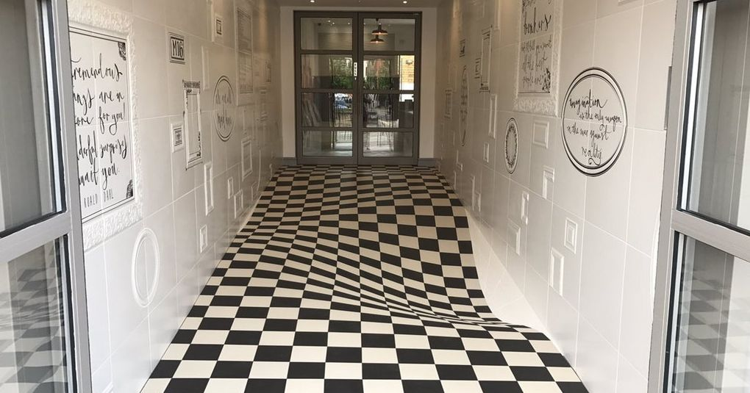
Do you want to walk on this floor? Checkered tile illusion

Slide 16
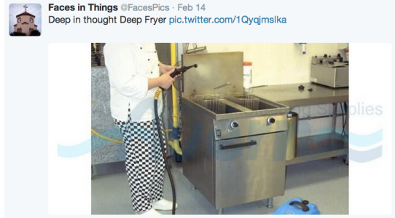
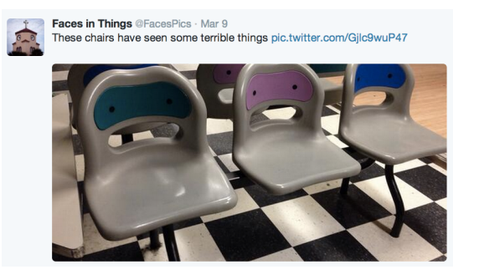
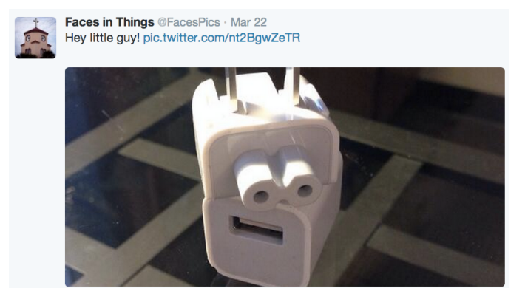
In-appropriate application of priors
Apply priors inappropriately
Pareidoia
We see faces (which our brains are very well trained to see)
Where there aren’t faces

Slide 17
Take home point
Vision is ”constructed” top-down from the input

Slide 18
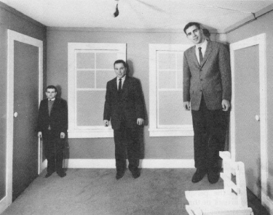
Human visual system
Relative judgments are strong
Absolute judgments are weak
Example: Size
We don’t perceive size absolutely
But in relation to the surroundings
Our brains makes a judgment of what the size is, it is not something we just see
Who is taller?

Slide 19
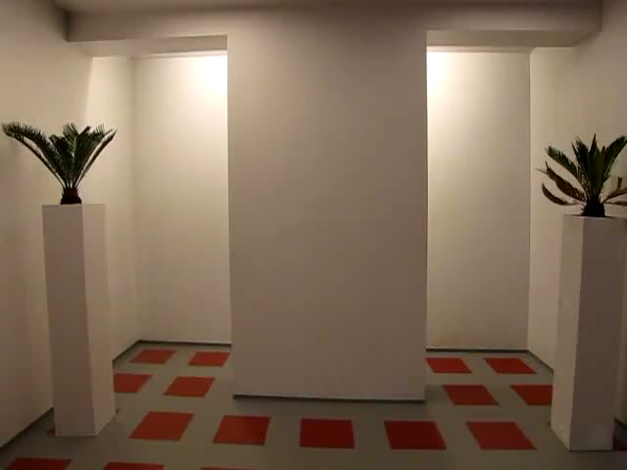
Tricked you!

Slide 20
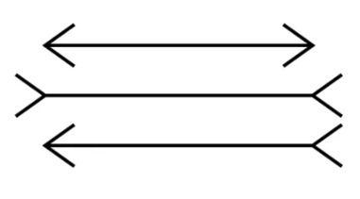
More on size estimation- Which line is the longest?

Slide 21
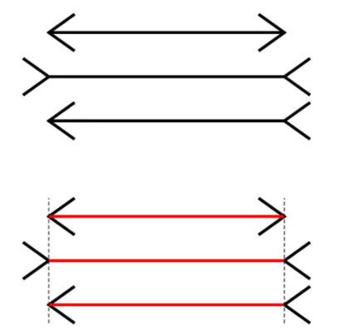
Muller-Lyer Illusion

Slide 22
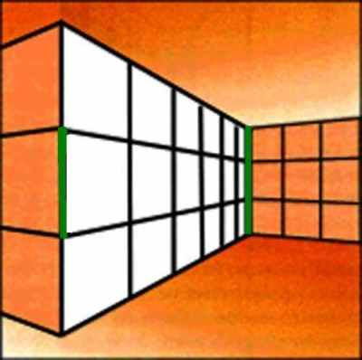
Which line is longer?

Slide 23
Which line is longer?
Tricked you- same size

Slide 24
Other judgements

Slide 25
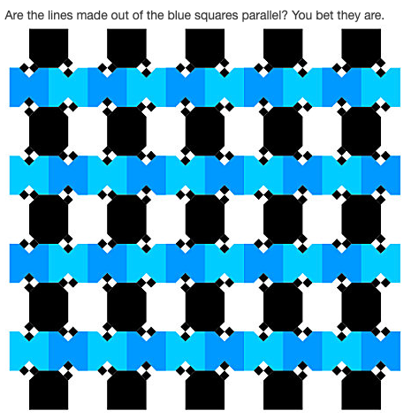
Are these lines parallel?

Slide 26
Are these lines parallel?
Yes

Slide 27
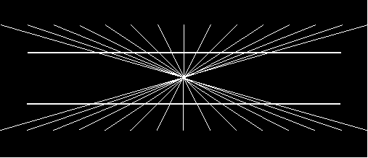
Are these lines bent or parallel?

Slide 28
Are these lines bent or parallel?
False cue to depth makes them appear bent

Slide 29
Color estimation
We don’t perceive color absolutely
But in relation to the surroundings
Our brains makes a judgment of what the color is, it is not something we just see

Slide 30
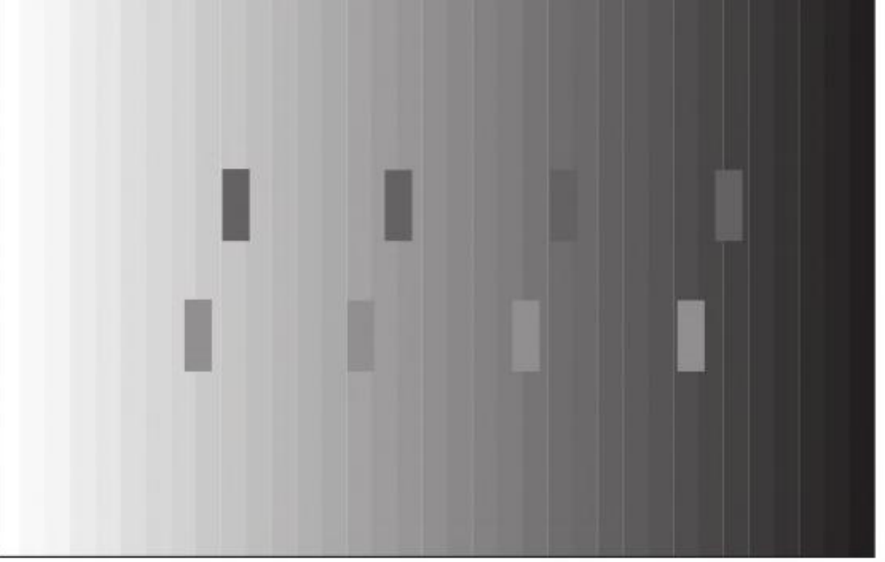
Which rectangles are the darkest? Lightest?

Slide 31


We don’t perceive colors absolutely But relative to surroundings

Slide 32
We don’t perceive colors absolutely But relative to surroundings

Slide 33
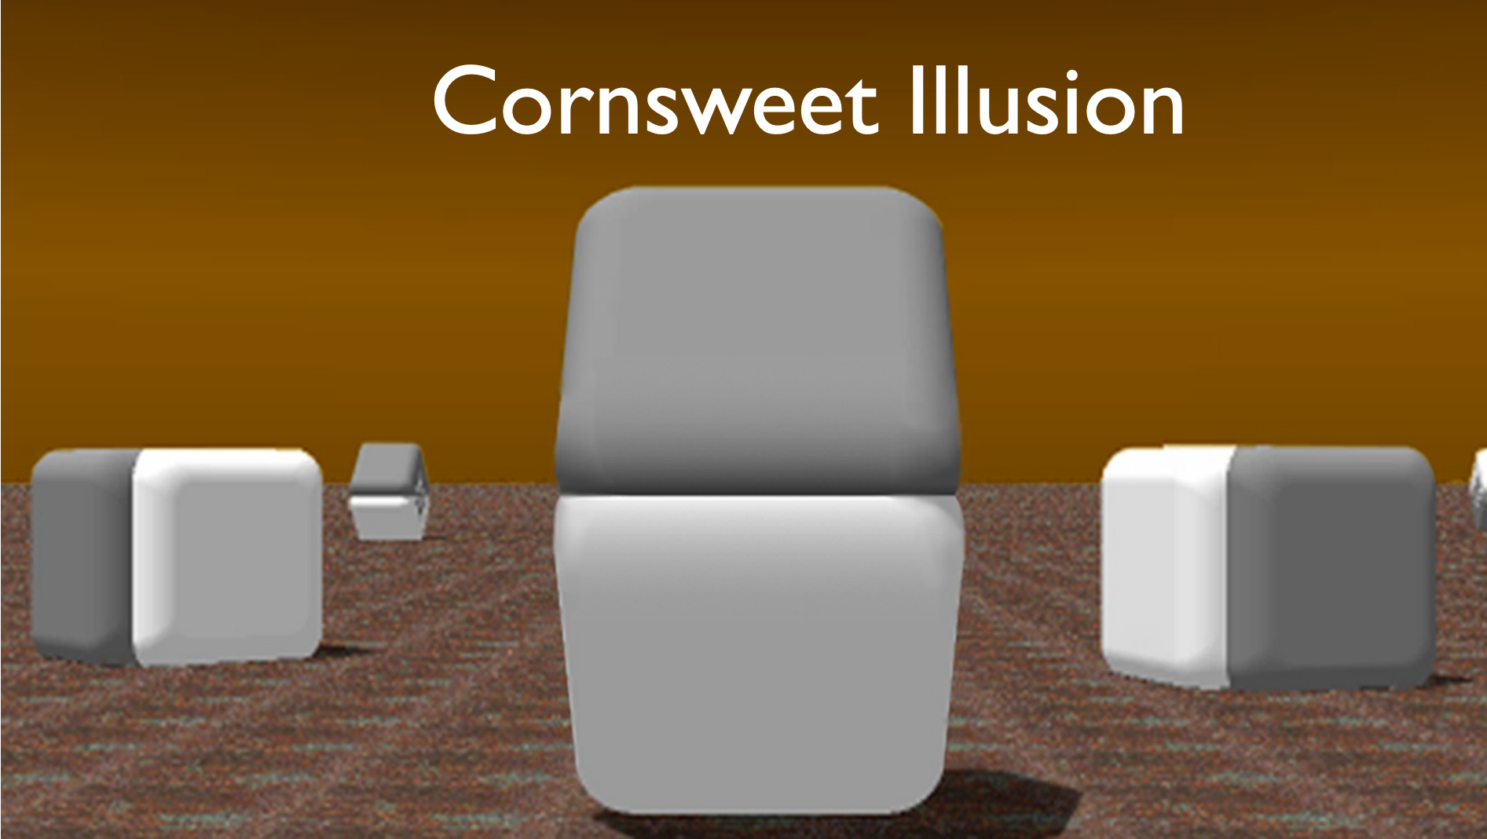
Which is darker?

Slide 34

Which is darker?

Slide 35
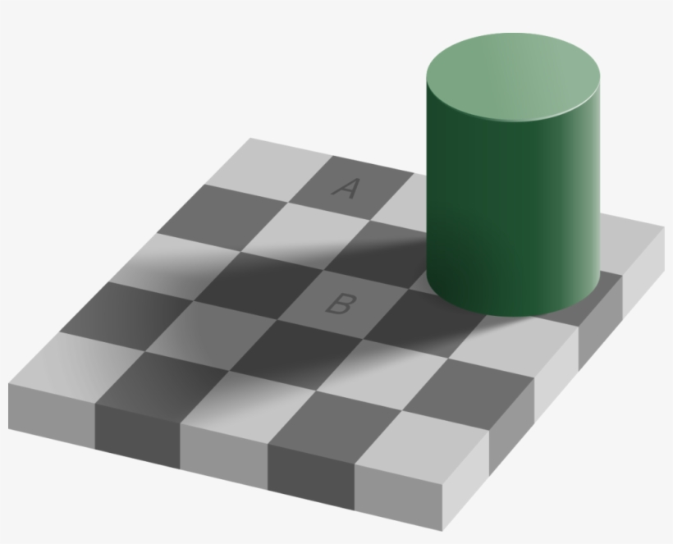
Describe the color of A? B? Dark gray and light gray?

Slide 36

Describe the color of A? B? Dark gray and light gray?

Slide 37
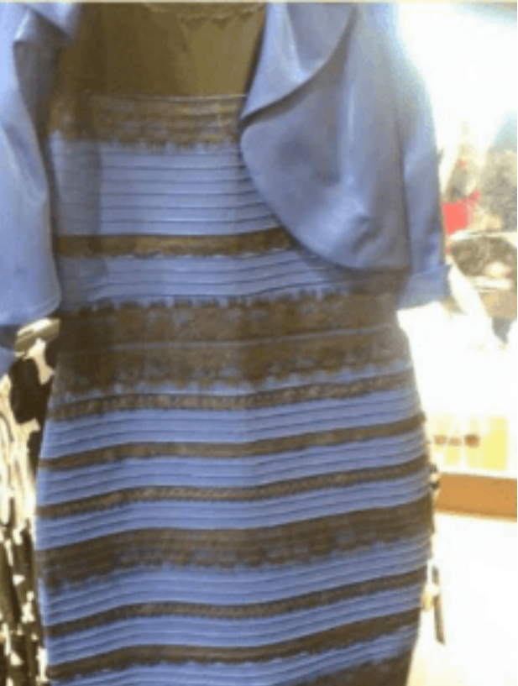
The dress
What colors are in the dress?
Black and blue?
White and gold?

Slide 38
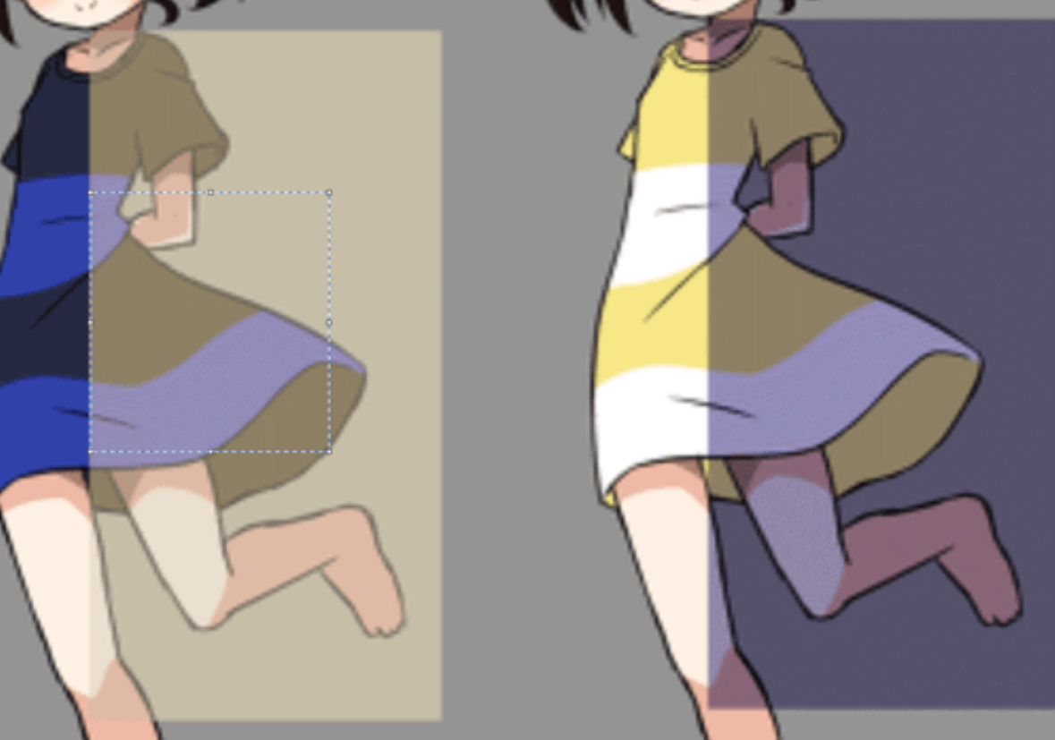
The dress
It actually is blue and black but….
Your brain makes an estimate of the color based on what is perceives to be the lighting in the room
People now study this….
57% blue and black
37% white and gold

Slide 39
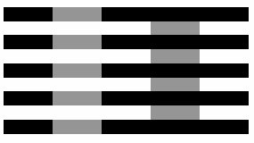
Placement matters

Slide 40

Placement matters

Slide 41
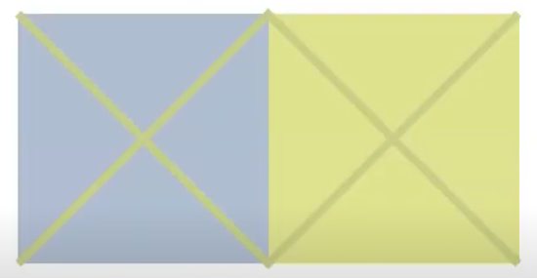
Interaction of color: background effect

Slide 42
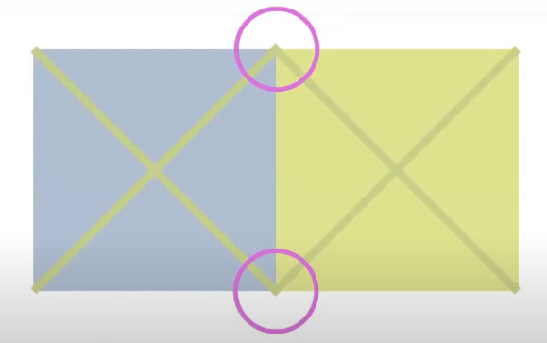
Interaction of color: background effect

Slide 43
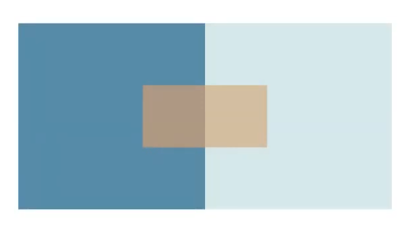
Placement matters in color perception
Close together these colors look different

Slide 44
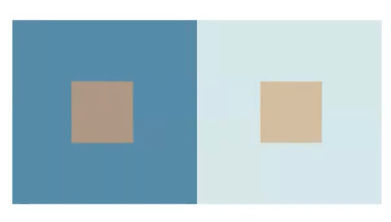
Placement matters
Move them apart, and they look more similar

Slide 45


Influence of background color
Dogs are the same color

Slide 46
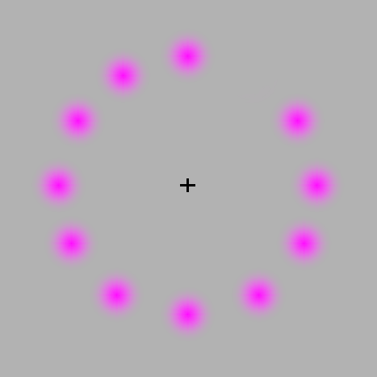
Complementary color illusion
Pac-Man illusion
afterimage is a complementary color
(green as opposite to lilac).
Follow the movement of the rotating pink dot with your eyes and the dots will remain only one color, pink.
But if you stare at the black + in the center, the moving dot will turn green.

Slide 47
Take home point
Vision is ”constructed” top-down from the input
NOT just passively scanned and read in

Slide 48
Change blindness
https://www.youtube.com/watch?v=FWSxSQsspiQ&t=69s

Slide 49
Gradual change test
https://www.youtube.com/watch?v=1nL5ulsWMYc

Slide 50
Attentional blindness
https://www.youtube.com/watch?v=vJG698U2Mvo

Slide 51
Implications for UI
We don’t notice changes
We can’t attend to everything
Don’t assume the user will see a change in your interface
You need to design to visually attract their attention
Flashing elements
Transitions
Auditory cues

Slide 52
How do we see things in the first place?
Is our visual system like a camera?
where all the light comes in, strikes our eye, registers in our brain?

Slide 53
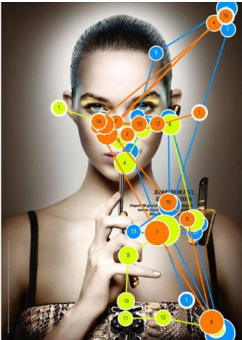
Human visual system
Our experience may feel like vision is like a camera but….
Vision is a sequence of
Fixations- maintain our gaze on a single location (200-600ms)
Saccades- move to a different location (20-100ms)
This is unconscious, happens so quickly you don’t know it is happening
Illustration: eye tracking data- where did someone look if you track their eyes

Slide 54
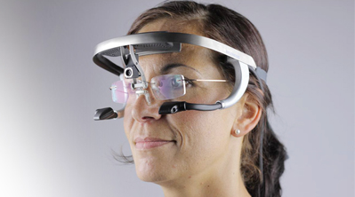
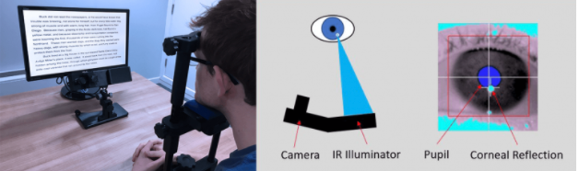
Eye tracking

Slide 55
Example of where we are looking
https://www.youtube.com/watch?v=DIEO0ZHgLSU

Slide 56
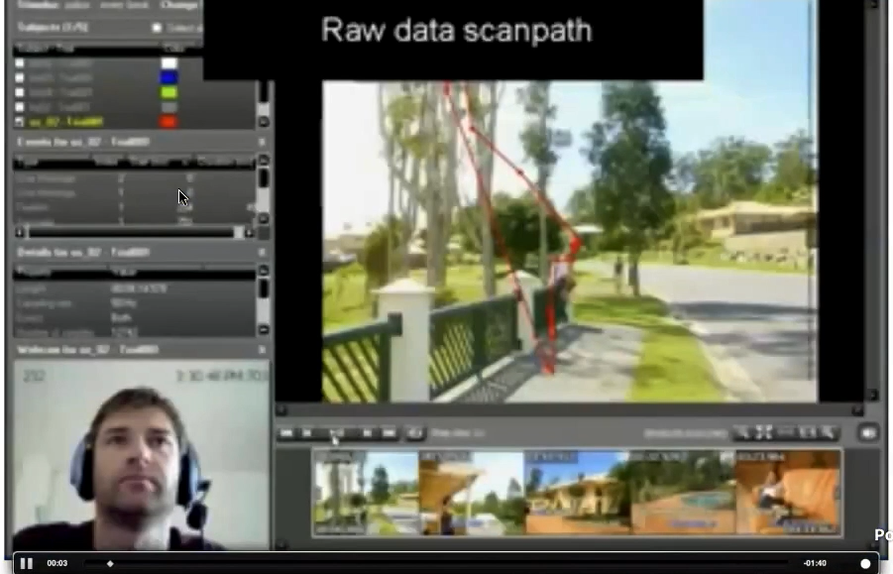
Eye fixations and reading

Slide 57
How is this relevant
You can study eye movements and visual interfaces
Ensure that users are seeing what they want them to see
Good to know that we aren’t registering the whole picture uniformly
Reason to think about how to organize content
How do we draw a user’s attention

Slide 58
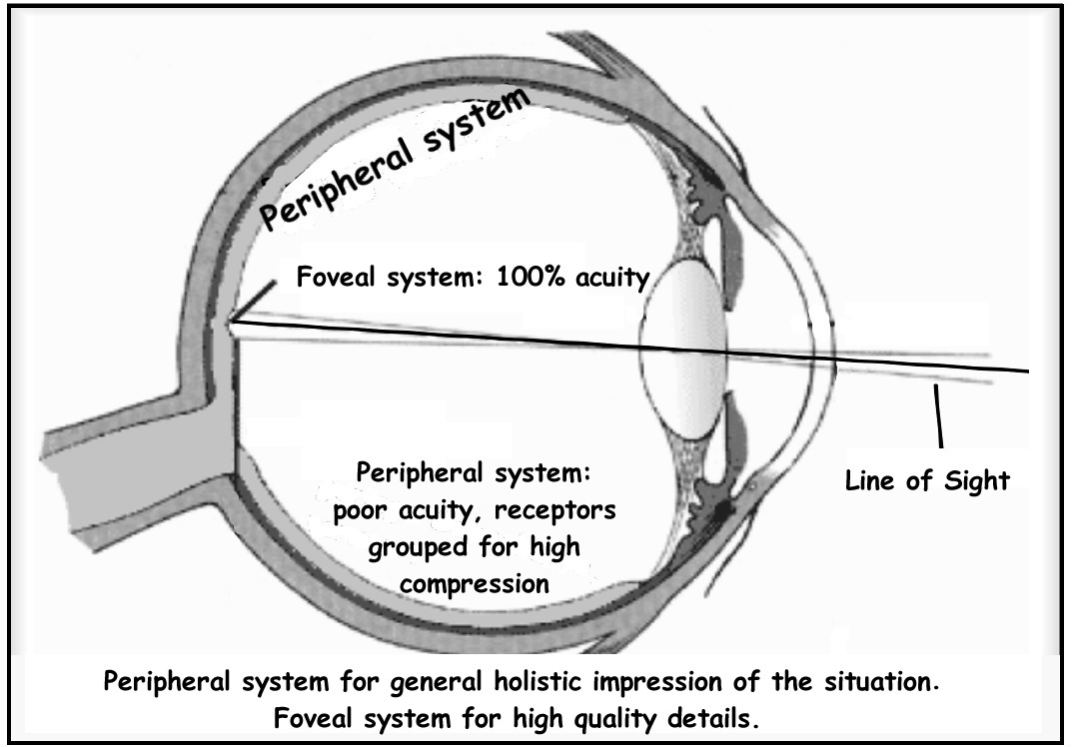
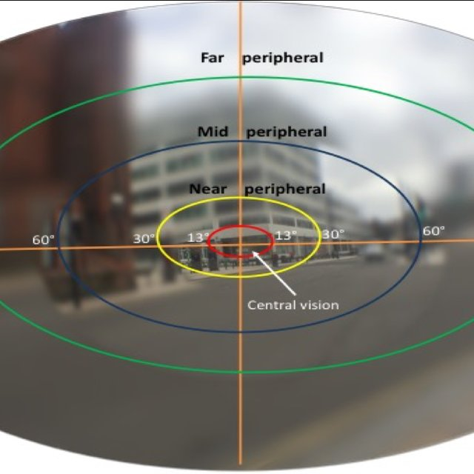
Central and peripheral vision
Vision can be separated into central and peripheral vision
Central vision looks directly at objects
Peripheral vision is used to grab attention, and responds strongly to movement
If we want the user to concentrate on a particular task or area, no flashing elements to distract them in their peripheral vision
Distracting
Or- if you want to grab the user’s attention, can use color and movement

Slide 59

Faces
We are wired to pay special attention to faces
We recognize and react to faces faster than other types of objects
We look where a face looks
We may not be conscious of seeing the object
Use faces to attract and direct attention

Slide 60
We talked previously about different visual channels for design
Let’s dig into which are stronger

Slide 61
Experiment
Let’s test how quickly you detect the target when surrounded by distractors
This is going to be a bit difficult to measure, because it is fast, but just for illustration…
Clap when you spot the target

Slide 62
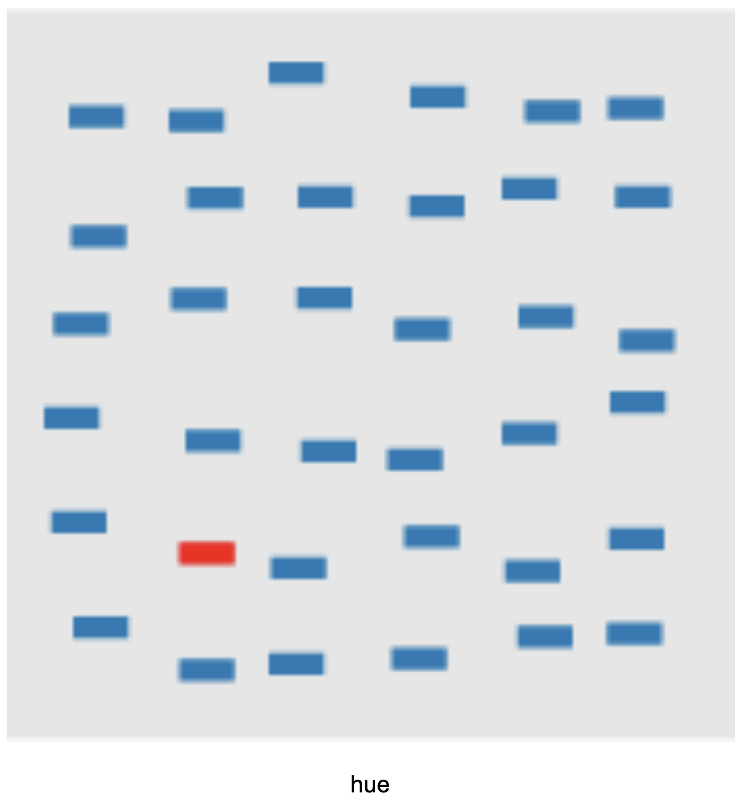
Hue

Slide 63
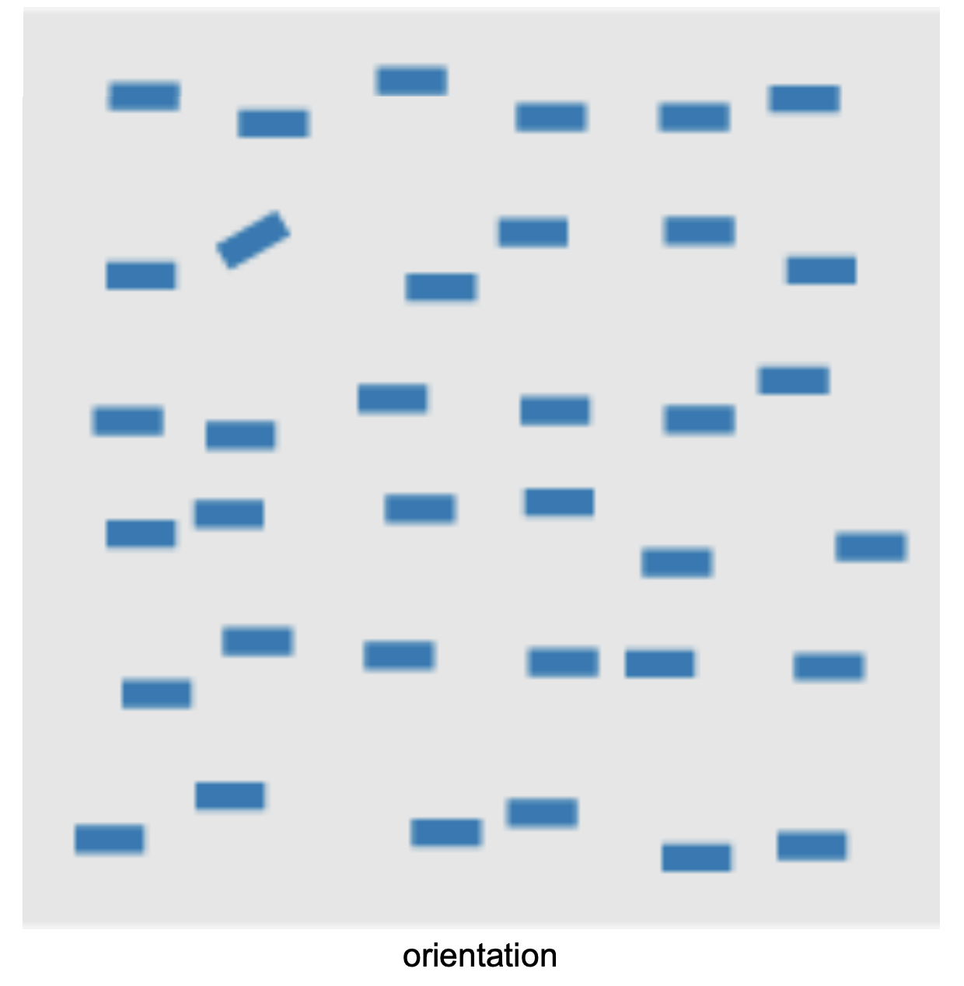
Orientation

Slide 64
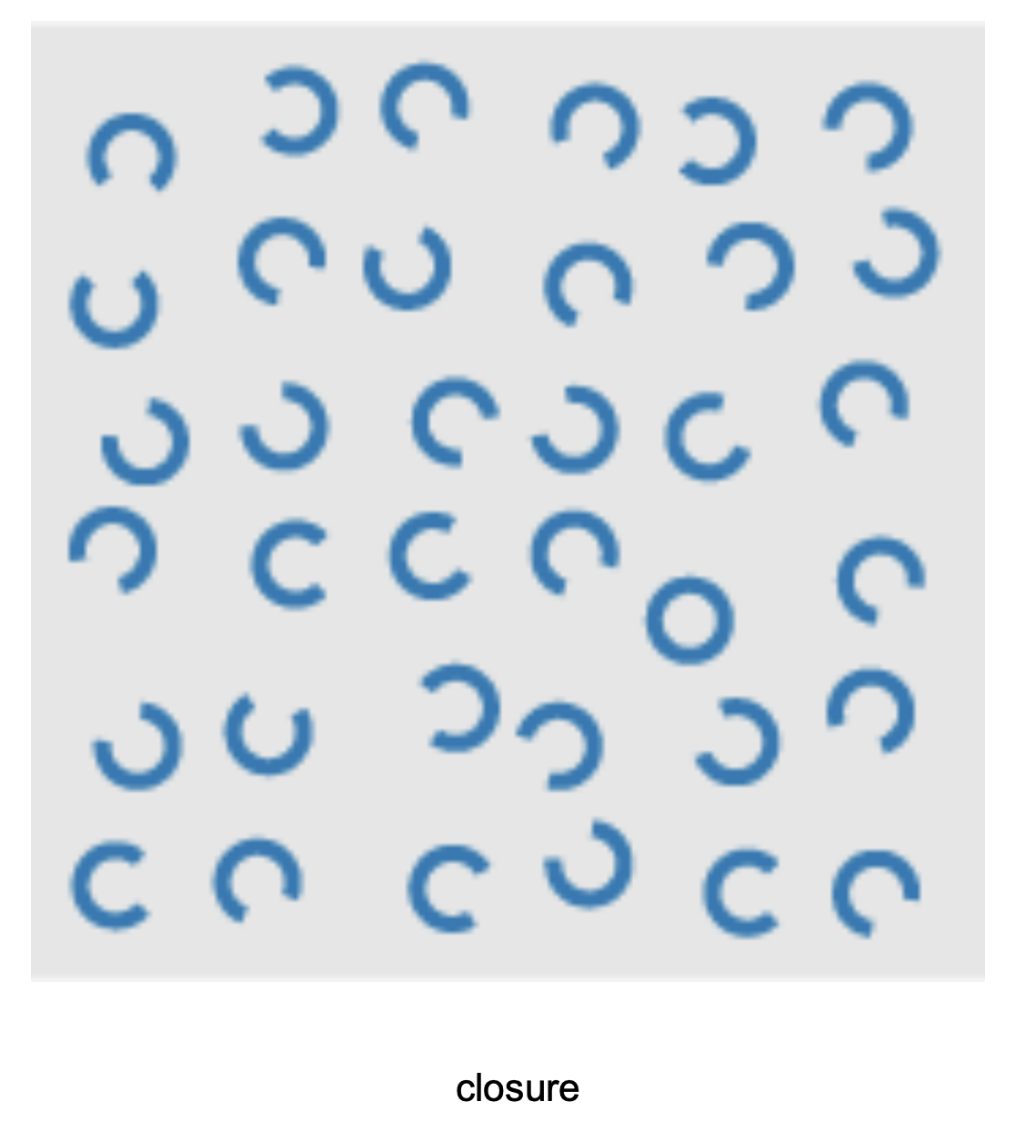
Closure

Slide 65
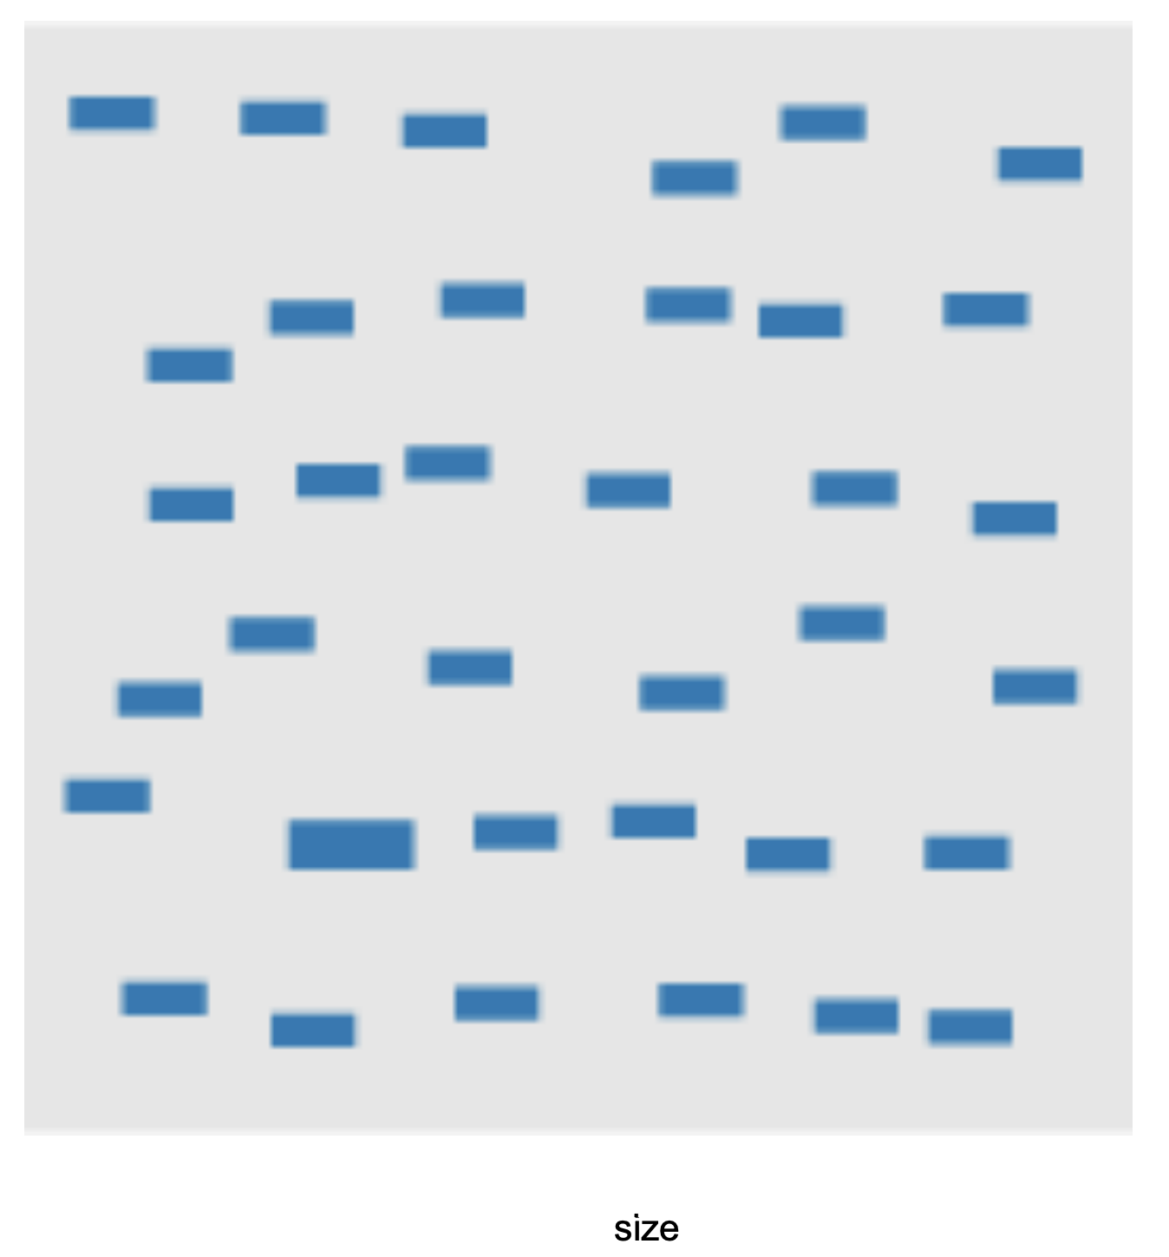
Size

Slide 66
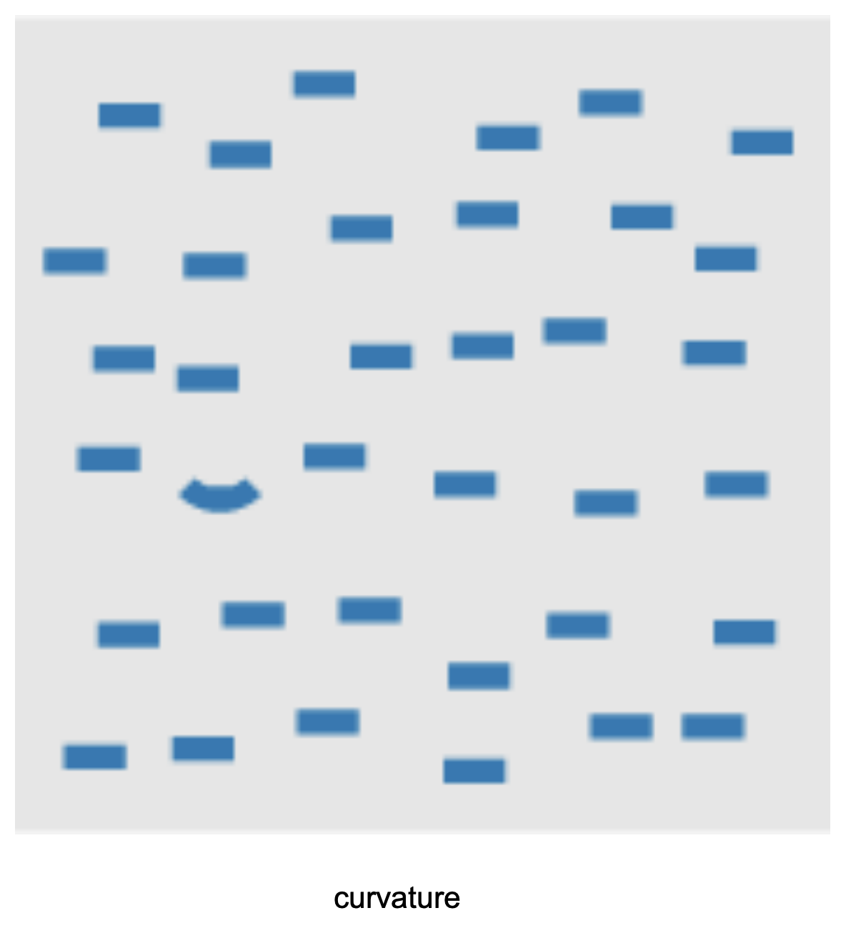
Curvature

Slide 67
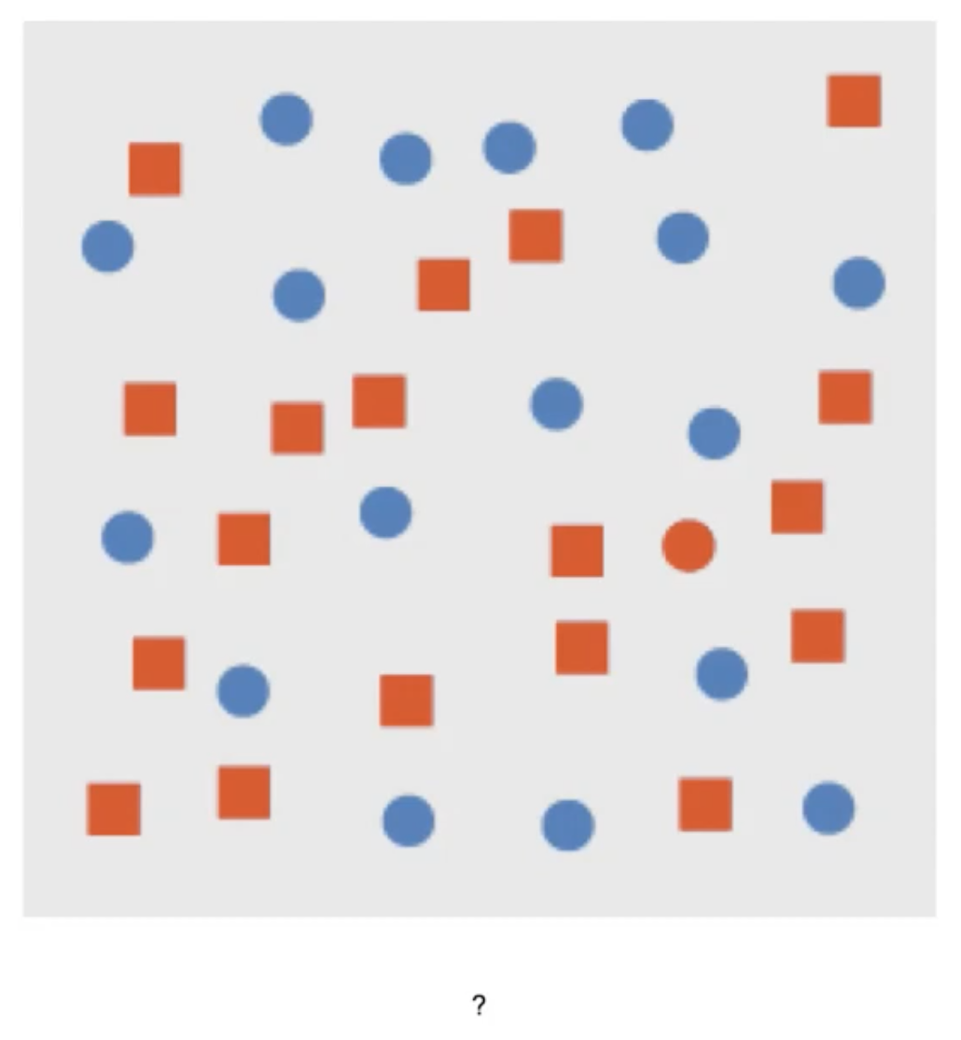
?

Slide 68
Combination
All circles are blue
All rects are red
Except our target: a red circle

Slide 69
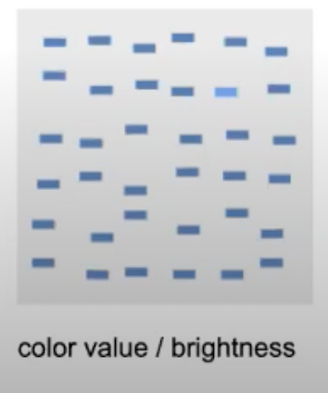
Brightness

Slide 70
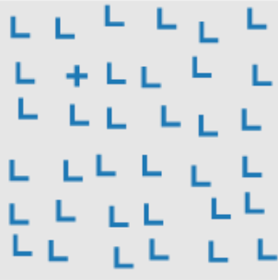
Intersection

Slide 71
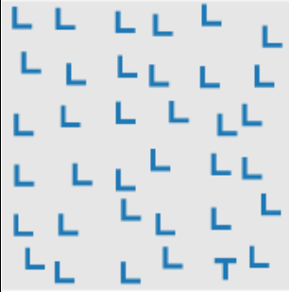
Terminators

Slide 72
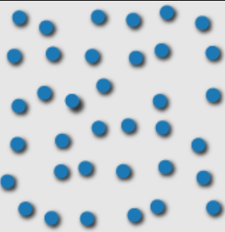
3D depth cues

Slide 73
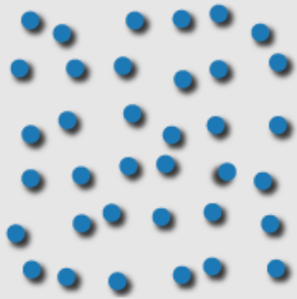
Lighting direction

Slide 74
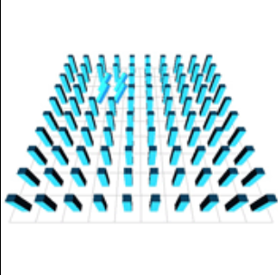
3D orientation

Slide 75
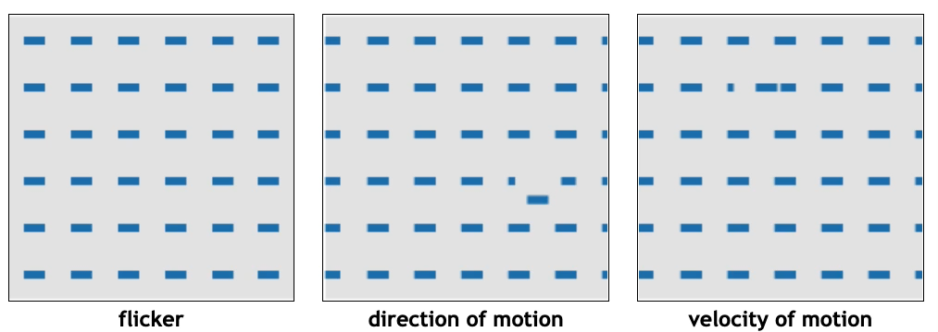
Animations

Slide 76
Some of these were faster, more accurate than others…

Slide 77
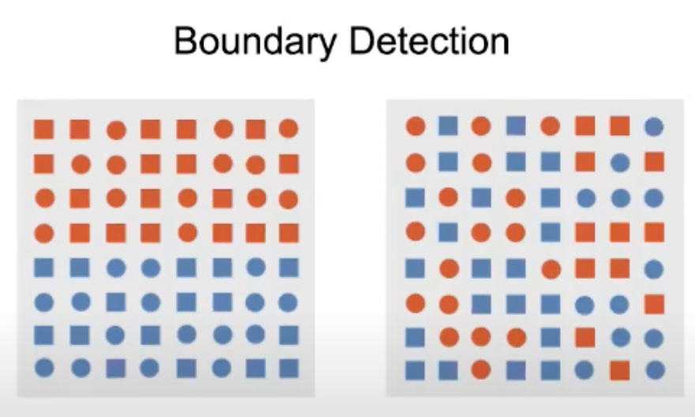


Perception, visual properties and tasks
Target detection
Detect the presence or absence of a target
Boundary detection
Identify the boundary between two groups of elements- with elements in each group having a common visual property
Number estimation
How many targets with a unique visual element
Density estimation

Slide 78

Comparing visual features- which is stronger for a task?
Some visual features are stronger for a
particular task
(Eg. Boundary detection with hue vs shape )

Slide 79
Activity today- project 2
Consider the context for your object. What are you competing with for your viewer’s attention? Do you want to draw your user’s attention away from their environment?
Are there changes in system state that you want to convey to your users? How can you convey these messages? Do you want this to be subtle or strong?
How will you provide feedback on user actions?

Slide 80
Credits
PhD Comics
XKCD
University of Utah Visualization Course, Alex Lex
University of British Columbia Visualization Course, Tamara Munzner
New York Times

Slide 81
Credits
https://www.youtube.com/watch?v=X1Q4IKvE5cA&list=PL3sGw6DVKZGgv_ulhumGVLp1OqN-esKtv&index=2&t=24s

